Slide 1



GIT
Web-Scraping & AI Large Language Models to support Philanthropy Research
Giuseppe Ugazio
Lucia Gomez Teijeiro
Google colab
Get Ready ☺ !
- Install Firefox
- Install the Selenium IDE extension
- Copy the Colab file to your Google Drive

Slide 2



Outline
The AI Jungle
Get your Data
Derive Insights

Slide 3
The AI Jungle:
Data & Methods

Slide 4
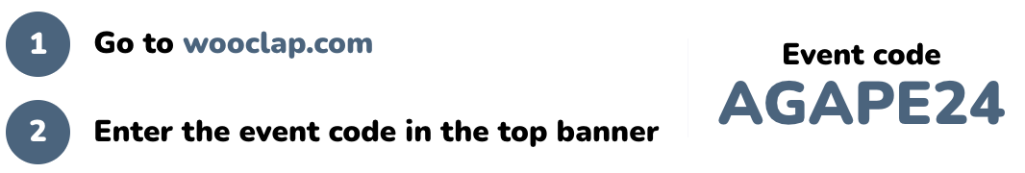

What is your position in the Jungle?

Slide 5

Where do you want do be?
Time to dream:
If you were an AI master, how would you apply to your research?

Slide 6
AI Diversity
Where do I start?
The AI Jungle:
Data & Methods
What can AI do for me?
AI needs Data

Slide 7
AI Diversity
Where do I start?
What can AI do for me?
AI needs Data

Slide 8
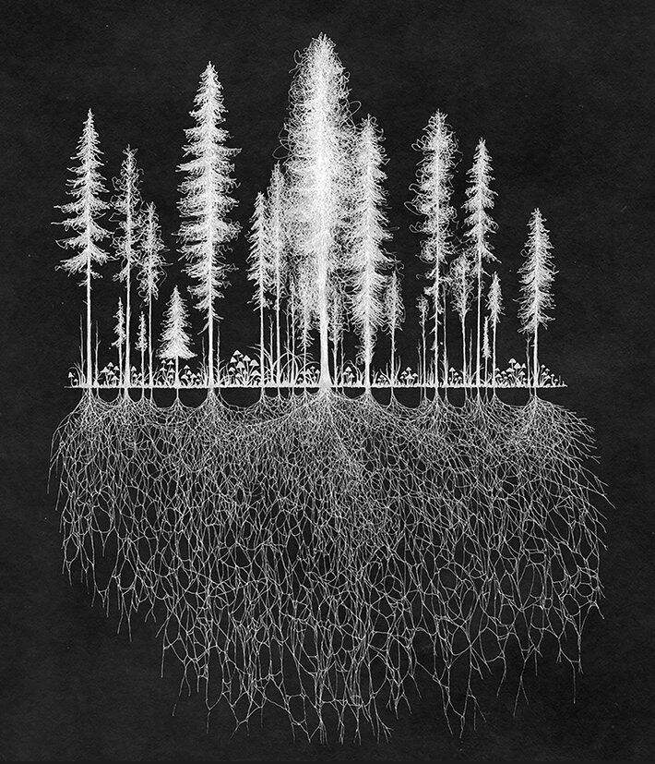
AI Diversity

Slide 9
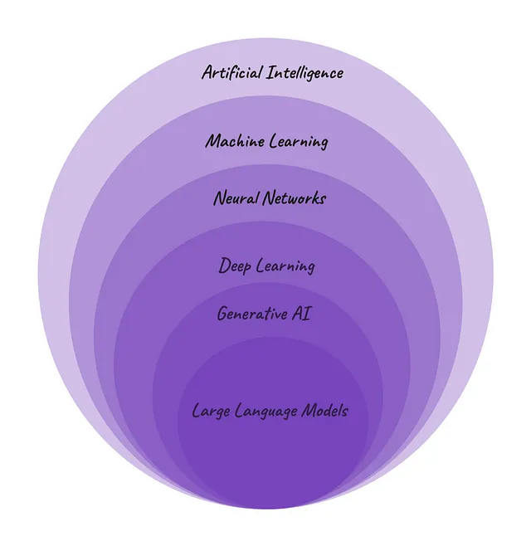
AI Diversity
Brach of Computer Science that aims at developing machines that think and act like humans.
Subfield of AI aiming at developing and training models able to learn from data without giving explicit instructions. Includes Supervised, Unsupervised and Reinforcement Learning
Subtype of ML models which architecture is inspired in the human brain as it is composed of connected artificial neurons.
Subset of NNs counting with Hidden Layers allowing to learn beyond linear patterns and tackle complex problems.
Subtype of DL models specialized in generating new and realistic content because of being trained in Very Big Data.
What everybody talks about
Generative AI models able to create human-like text based on the patterns learned from vast amounts of textual data.

Slide 10
AI Diversity
Where do I start?
What can AI do for me?
AI needs Data

Slide 11
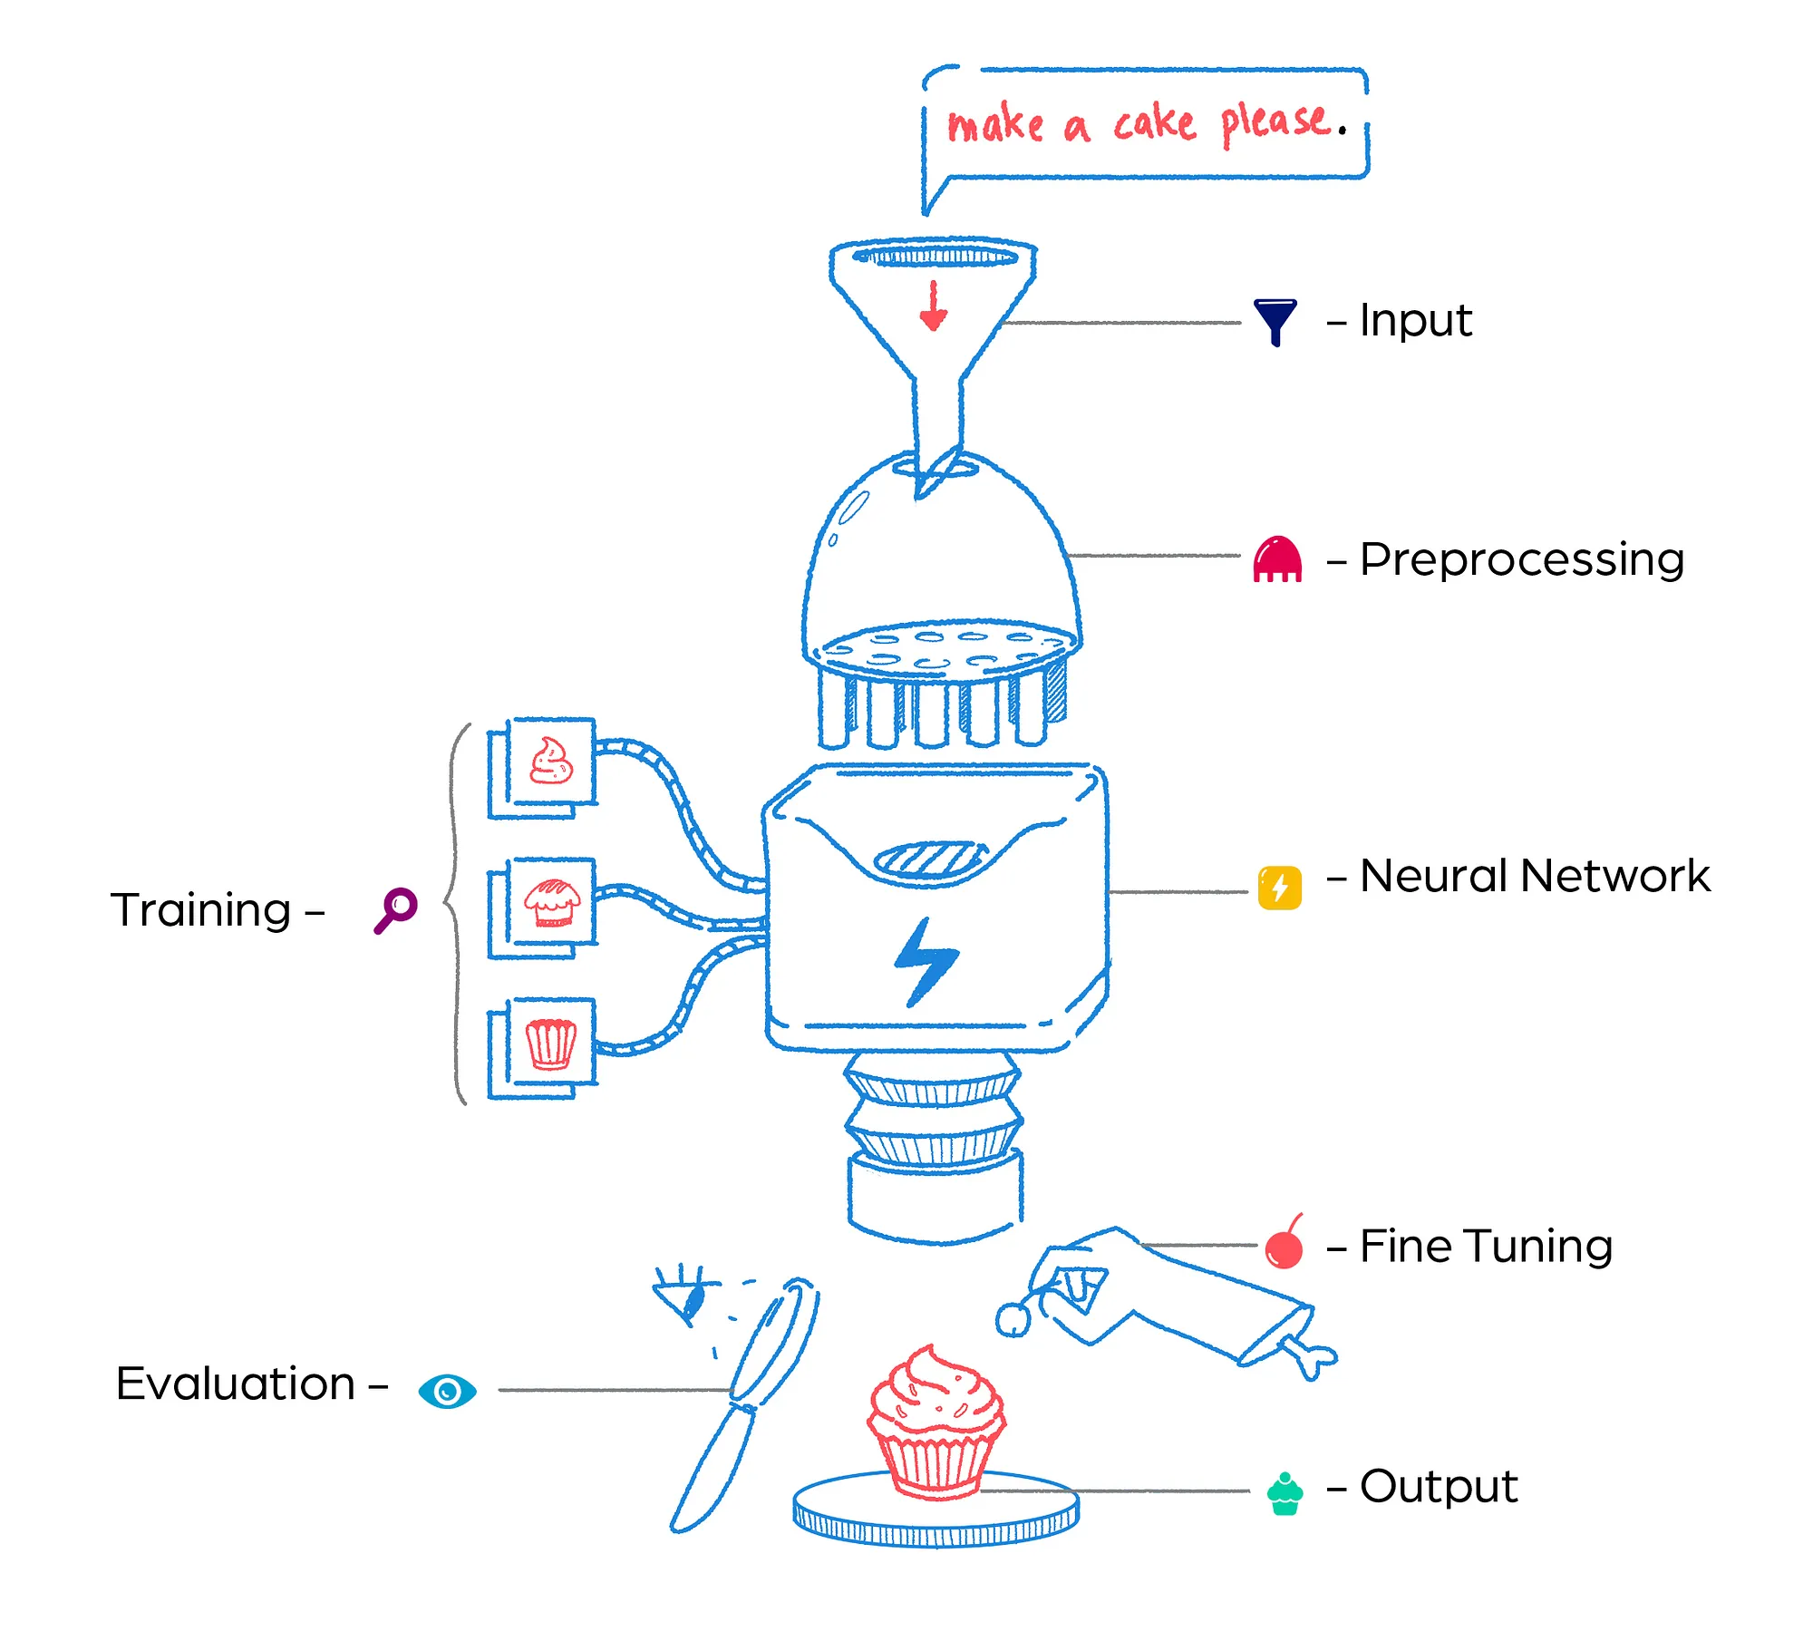
Generative AI & LLMs
Pretraining Data

Slide 12
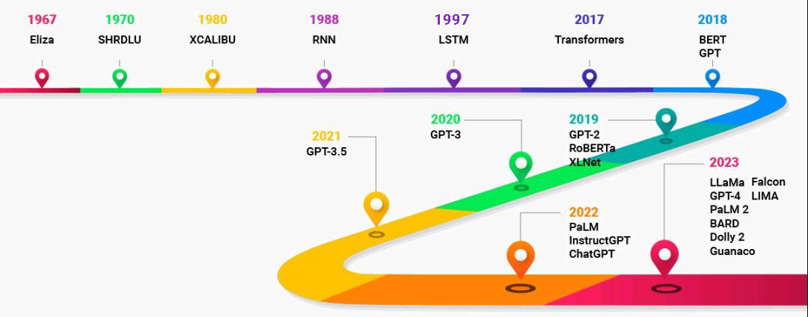
The long history of LLMs

Slide 13
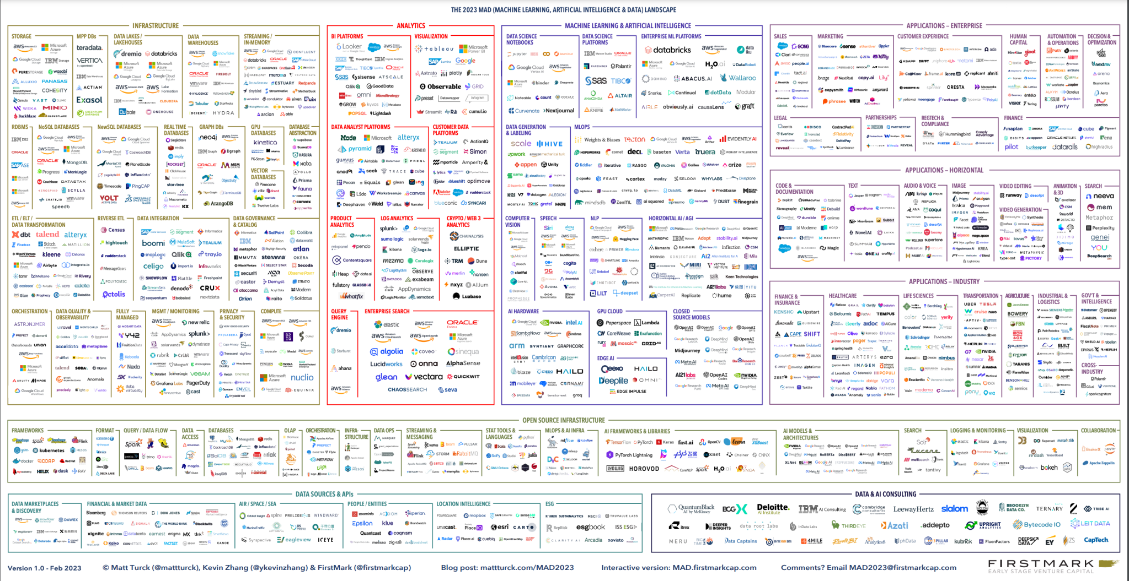
Where do I start?

Slide 14
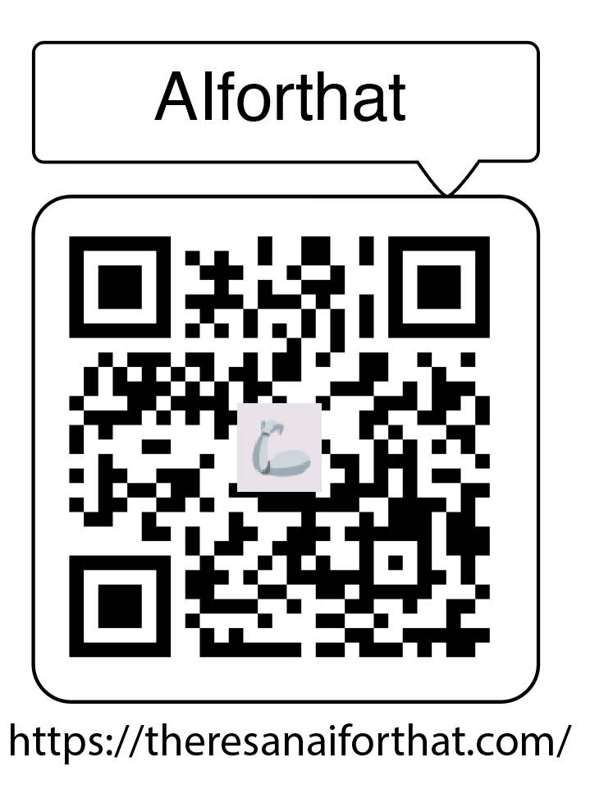


Slide 15
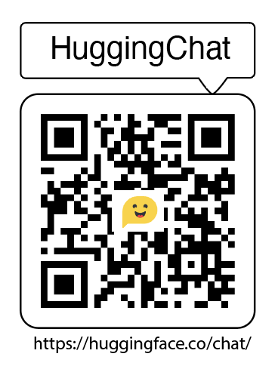

Slide 16
Let’s Explore & Create
Explore models
Explore assistants
You can create your own assistant !!!

Slide 17
AI Diversity
Where do I start?
What can AI do for me?
AI needs Data

Slide 18
What can AI do for me?

Slide 19






What can AI do for me?
Transform you in a super-human
https://www.heuristi.ca/
https://www.explainpaper.com/
https://typeset.io/
https://www.perplexity.ai/
https://elicit.com/
https://www.editage.com/

Slide 20
AI Diversity
Where do I start?
What can AI do for me?
AI needs Data

Slide 21
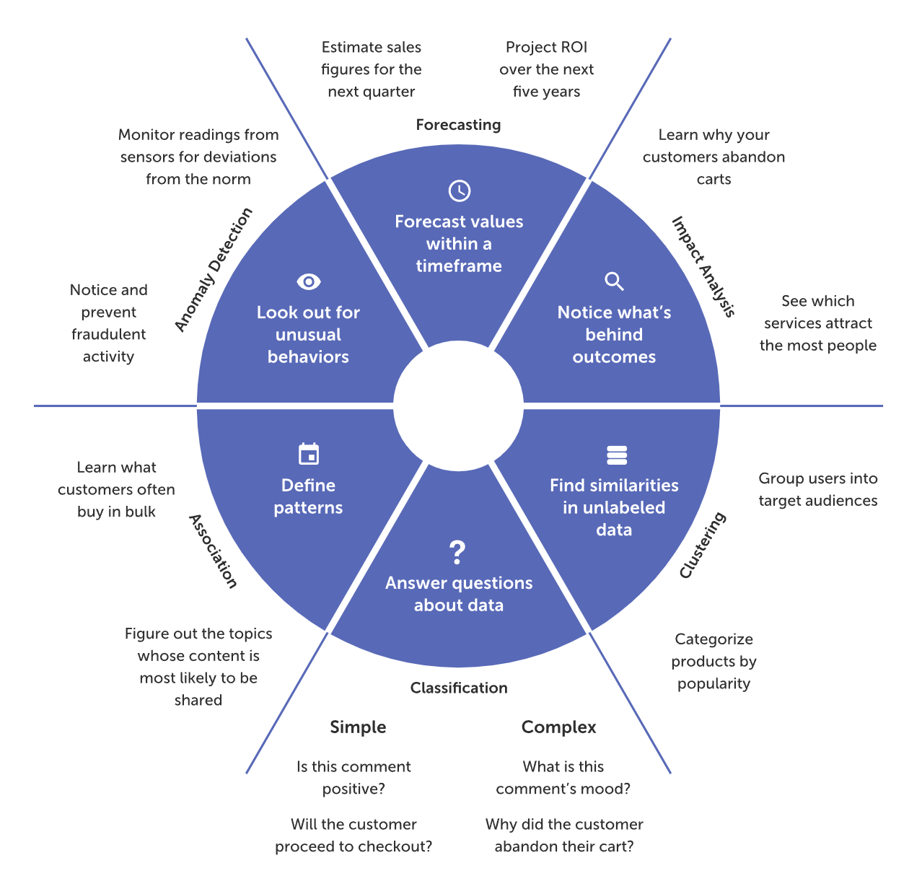
AI needs Data
Data types?
Data structures?
Labels?
Noise?

Slide 22

AI needs Data
the more high-quality training data you have, the better the AI you can develop

Slide 23
Get your Data

Slide 24
Have you ever wanted to gather data you know exists out there but is just all over the place?

Slide 25
Level 1:
Repositories / APIs
Level 2:
Scrapping Software
Get your Data
Level 3:
Request & Parse
Level 4:
Selenium

Slide 26








Level 1:
Repositories / APIs
Level 2:
Scrapping Software
Level 3:
Request & Parse
Level 4:
Selenium

Slide 27
Level 1:
Repositories / APIs
Level 2:
Scrapping Software
Level 3:
Request & Parse
Level 4:
Selenium

Slide 28
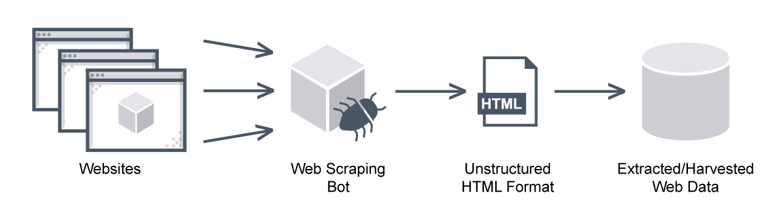
Level 3: Request & Parse
Easy to get data, difficult to clean
Only Static content

Slide 29
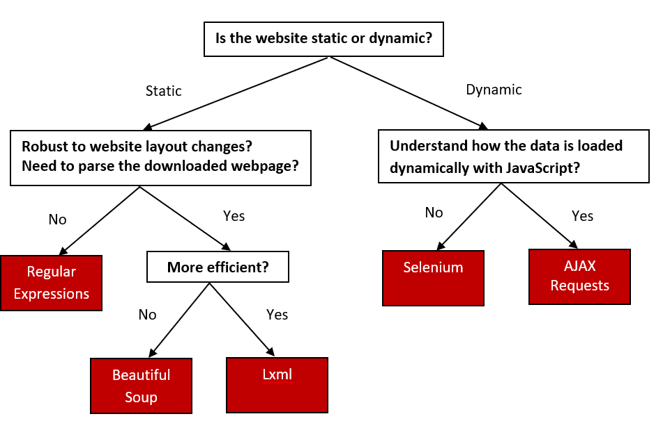
Level 4: Selenium

Slide 30
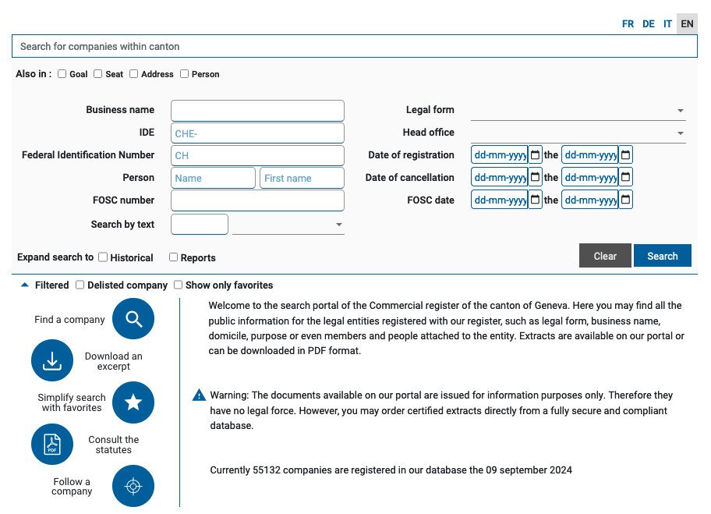
Let’s Scrape !!
Geneva Commercial Register: https://app2.ge.ch/ecohrcinternet/
This website is dynamic,
we need a solution allowing interaction
How can we programmatically set filters?
How to execute a custom search?
And if we are looking for a specific list of organization names?

Slide 31
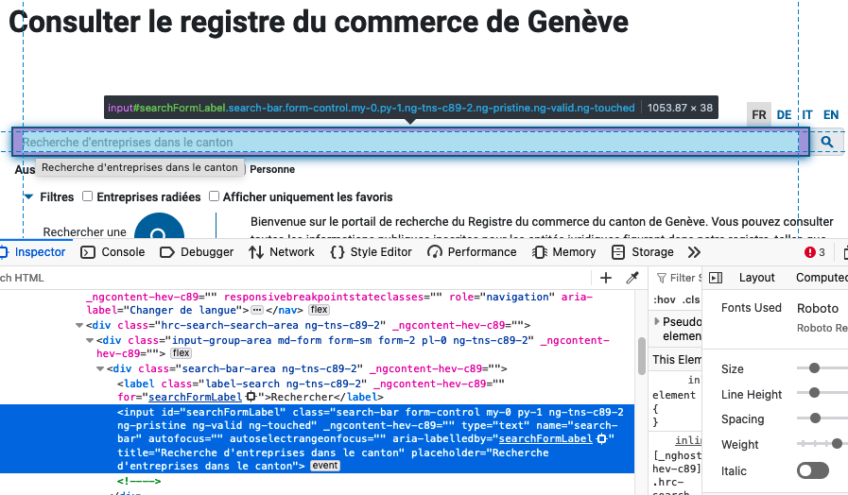
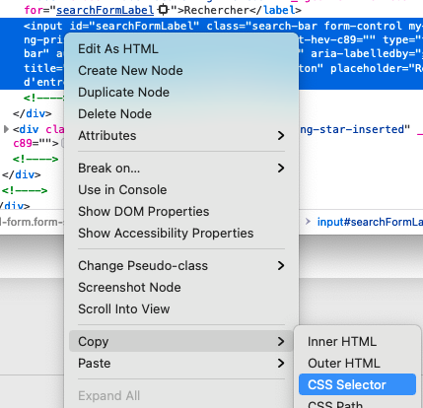
How to interact with a website? – The Inspector (Firefox)
1
2
#searchFormLabel

Slide 32
Why CCS Selectors are cool ☺ ?

Slide 33
Why CCS Selectors are cool ☺ ?
Because they allow to access different types of html elements

Slide 34
Why CCS Selectors are cool ☺ ?
Because they allow to access different types of html elements
Classes
IDs
Attributes
Tag types
.button
#header
“href”
<p>

Slide 35
Why CCS Selectors are cool ☺ ?
Because they allow to access different types of html elements
Classes
IDs
Attributes
Tag types
.button
#header
“href”
<p>
Unique to a single element of the website
Unique to a type of content
Usually have a functionality
Structure delimiters

Slide 36
Time to Play !!
Using Firefox browser,
inspect an element of your interest and retrieve its css selector

Slide 37
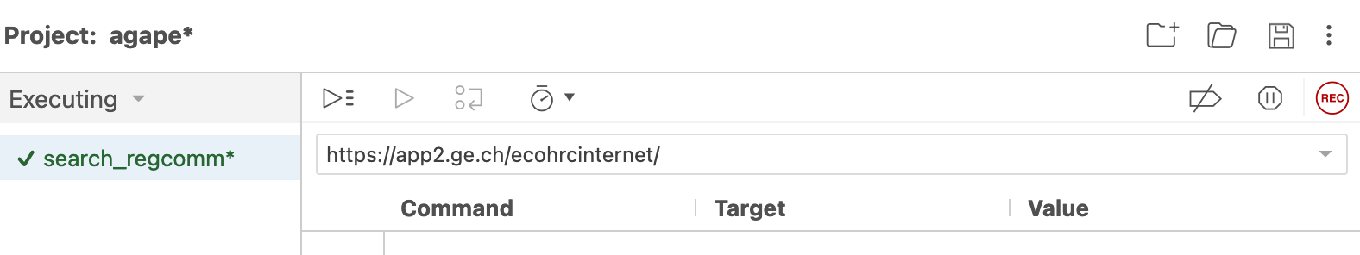
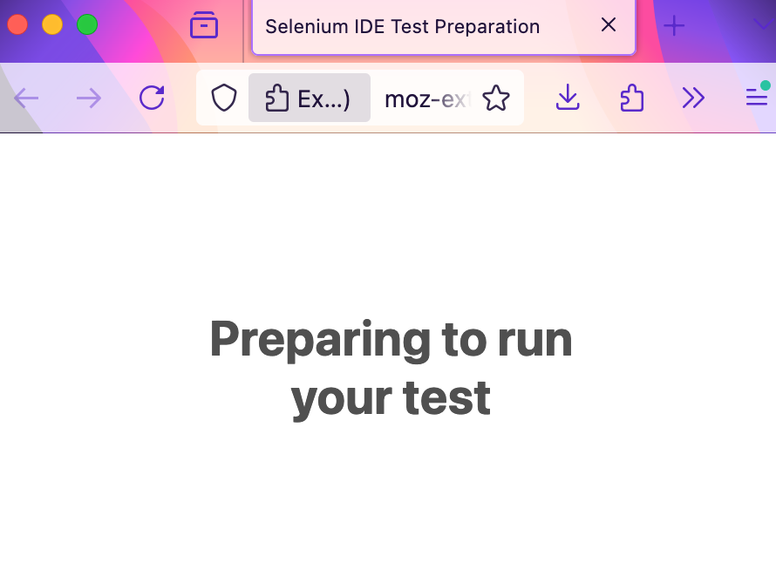
Level Up ! Selenium IDE
Visual Web Scraping
Go to Firefox
Install the Selenium IDE extension
Launch the extension
Launch the WebDriver
Start Recording
Interact to get what you want

Slide 38
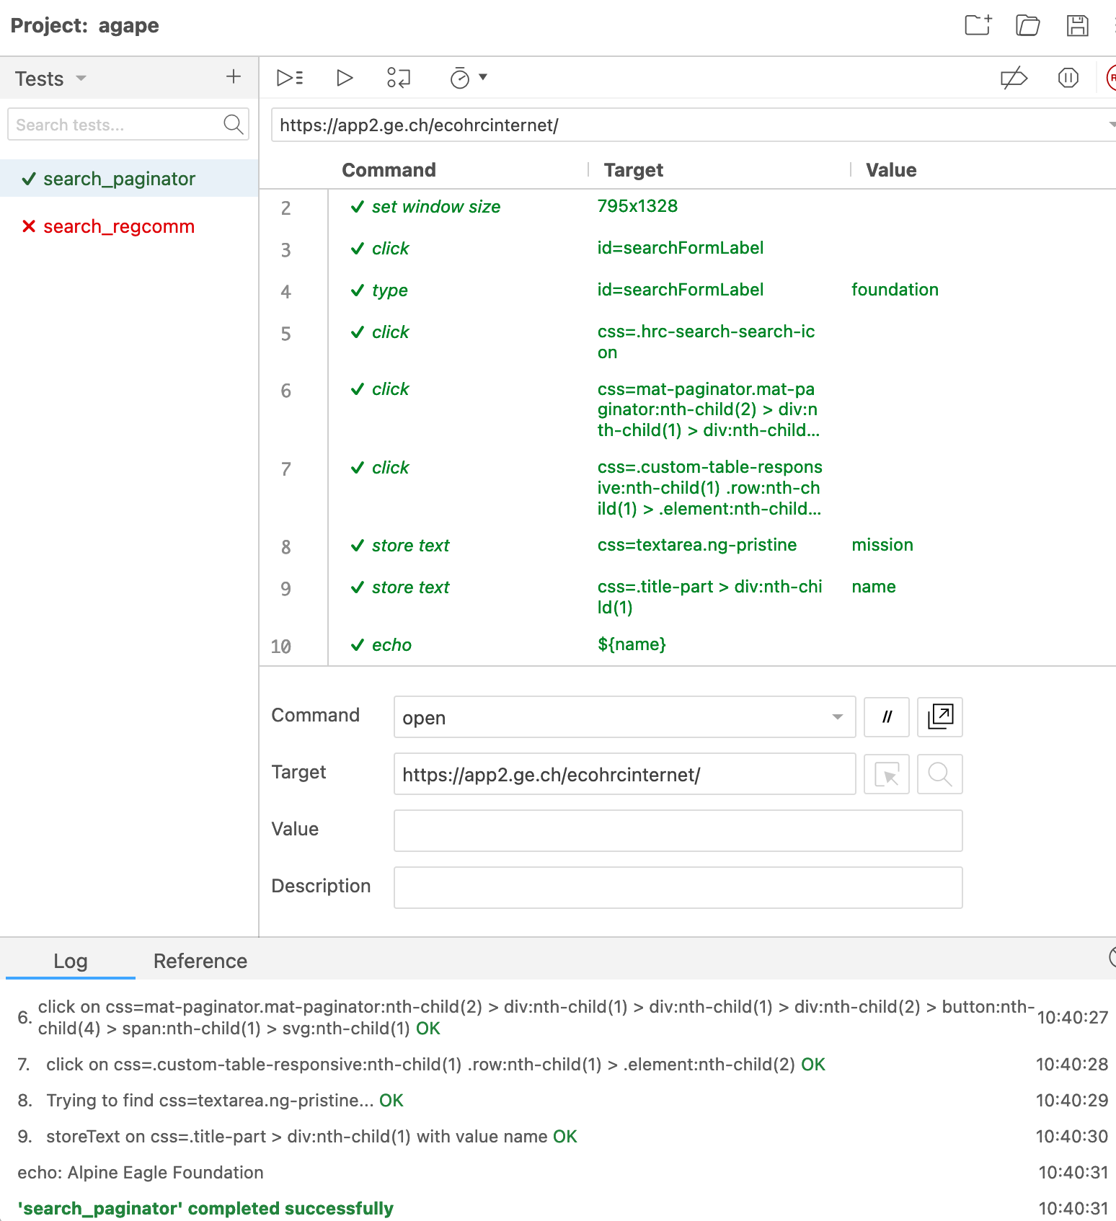
Level Up ! Selenium IDE

Slide 39
Your time to play
Using Selenium IDE,
record the steps for another process
(for example, to apply a search filter)

Slide 40
Your time to play
What did you do? Any insight? Issue?

Slide 41
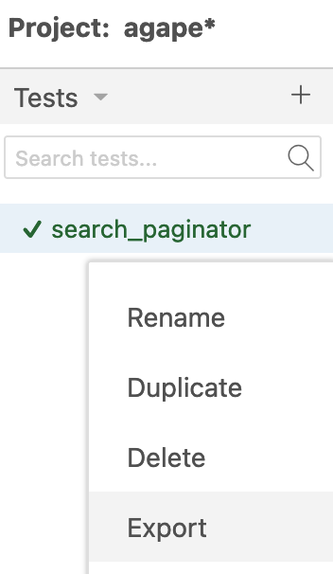
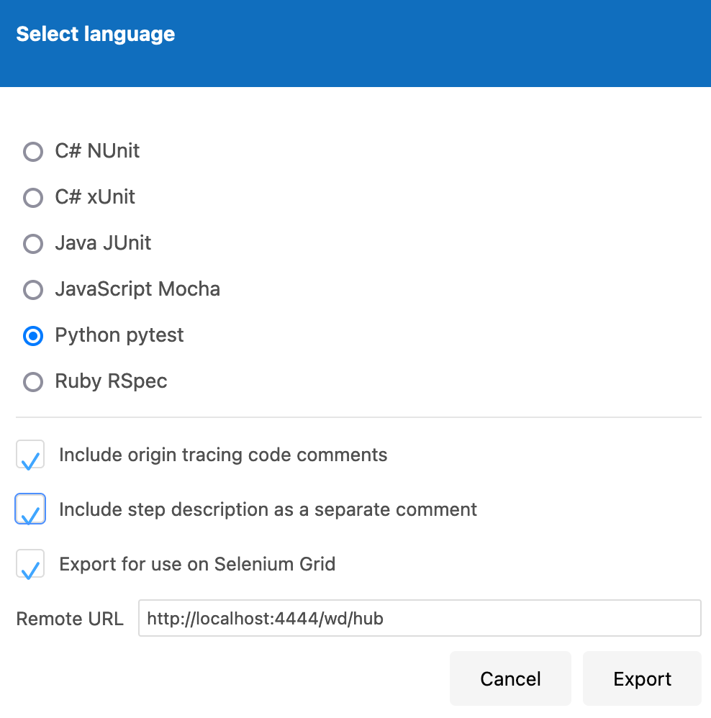
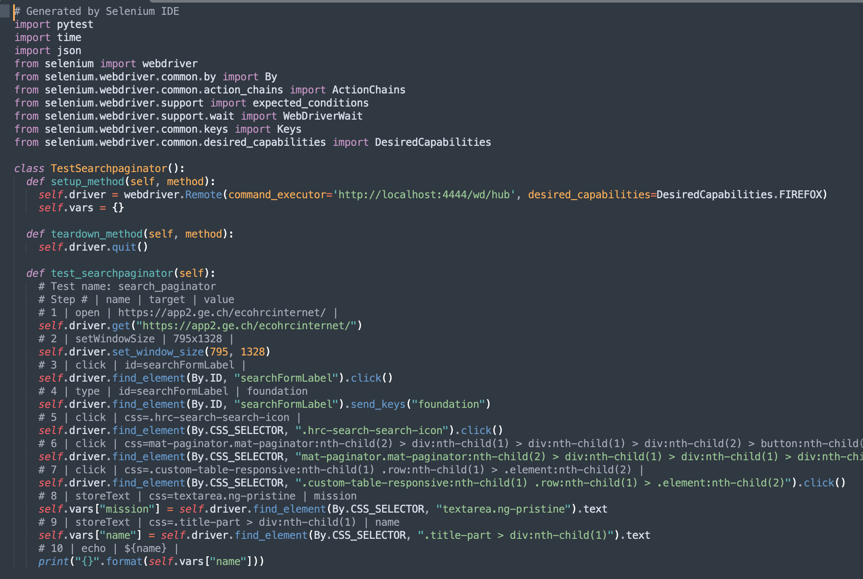
Level Up ! To Python
.hrc-icon-search

Slide 42
Join me at Google Colab through GitHub
https://github.com/gomez-L/tutorial_webscrap_LLMs

Slide 43
Derive Insights

Slide 44
Make it differently in the AI as a Service Era
Get Language Embeddings
Customize your Learning Task
Opt for Explainable AI
Access cutting edge AI

Slide 45
Make it differently in the AI as a Service Era
https://colab.research.google.com/drive/1Cqk2FuS9pr8KaS_Kgtq2zP8v-jd99xrM#scrollTo=vSRhRiUqsNM0

Slide 46

Resources
https://ui.vision/rpa/docs/selenium-ide/web-scraping
https://ui.vision/rpa/docs/selenium-ide/storetext
https://youtu.be/SfYZ1xiuPxk
https://www.guru99.com/store-variables-handling-selenium-ide.html
GitHub Education Pack

